Slide 1

Credit EDA Case Study

Slide 2

Business Objectives
This case study aims to identify patterns which indicate if a client has difficulty paying their instalments which may be used for taking actions such as denying the loan, reducing the amount of loan, lending (to risky applicants) at a higher interest rate, etc.

Slide 3
Data
This dataset has 3 files as explained below:
1. 'application_data.csv' contains all the information of the client at the time of application. The data is about whether a client has payment difficulties.
2. 'previous_application.csv' contains information about the client’s previous loan data. It contains the data whether the previous application had been Approved, Cancelled, Refused or Unused offer.
3. 'columns_description.csv' is data dictionary which describes the meaning of the variables.

Slide 4
Main Column
Target variable (1 - client with payment difficulties: he/she had late payment more than X days on at least one of the first Y installments of the loan in our sample, 0 - all other cases)

Slide 5
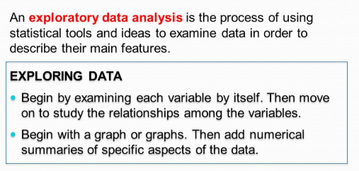

EDA

Slide 6
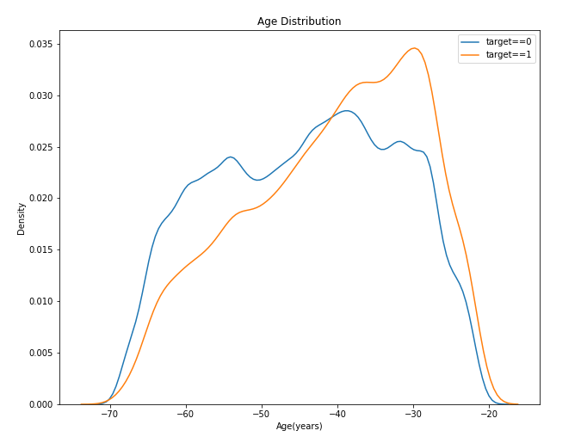
Age distribution for Target
As can see in graph that 35 to 28 age we have more density for target 1 and lower for target0
For 65 to 50 age density is higher as compare to target 1

Slide 7
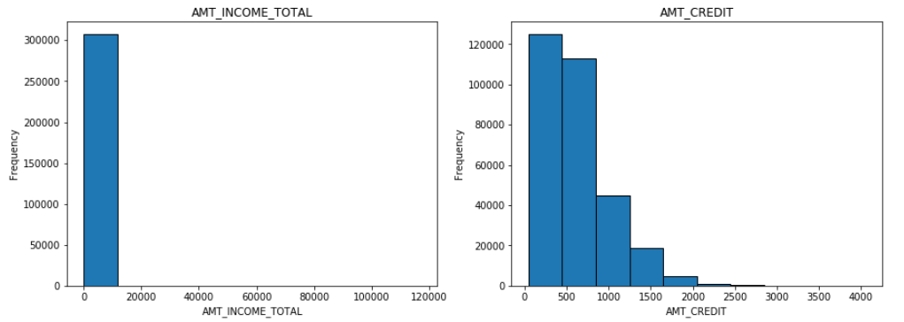
Hist plot for AMT INCOME TOTAL and AMT CREDIT

Slide 8
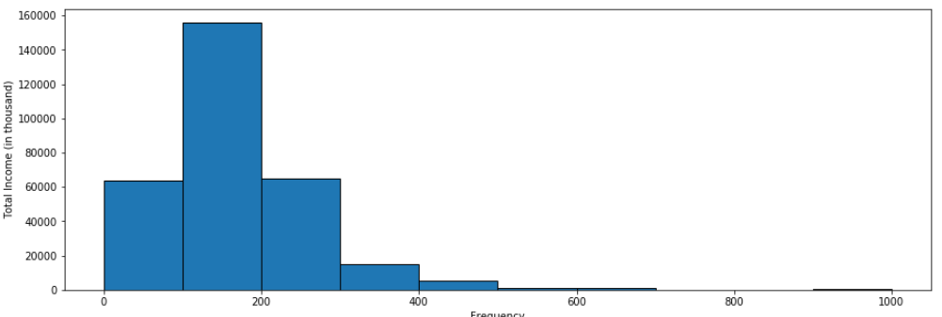
Histogram AMT_INCOME_TOTAL

Slide 9
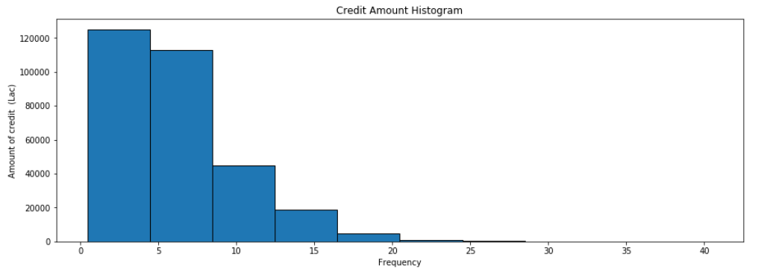
Histogram for Credit Amount Vs. Frequency

Slide 10
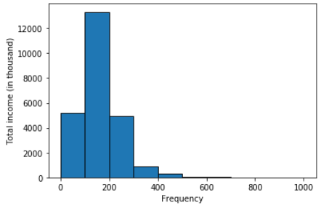
Histogram for Total Income Vs. Frequency

Slide 11
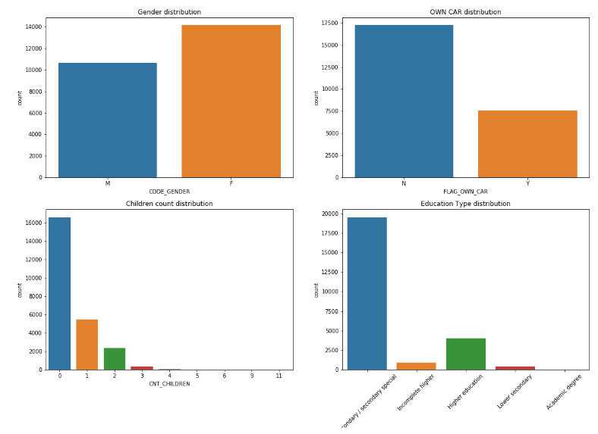
Distribution Graph for Target 1

Slide 12
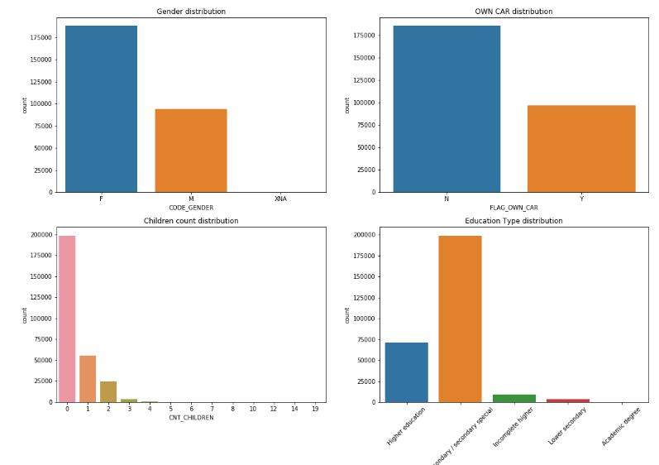
Distribution Graph for Target 0

Slide 13
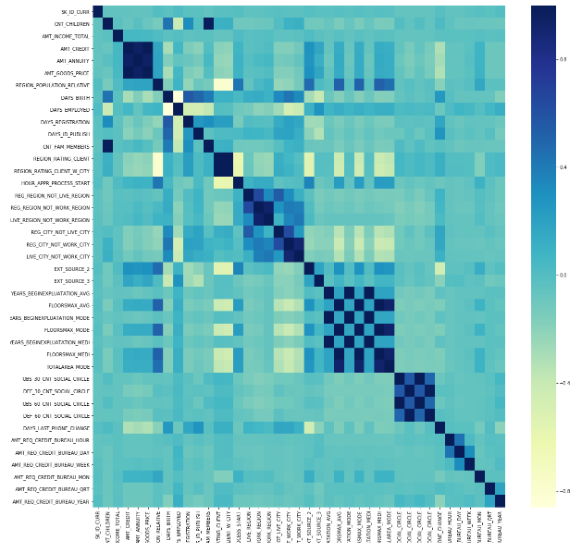
Correlation Heat map for Target 1

Slide 14
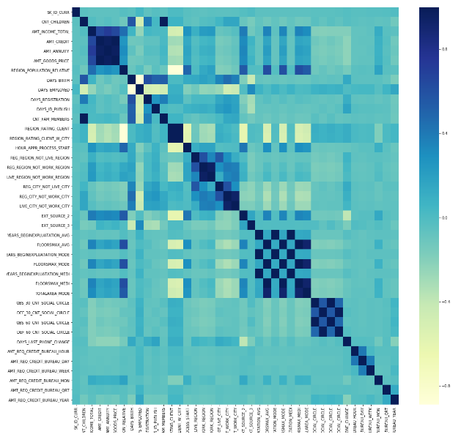
Correlation Heat map for Target 0

Slide 15
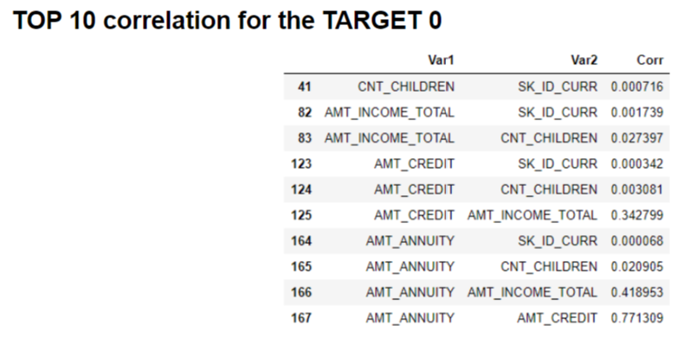
Top 10 Correlation

Slide 16
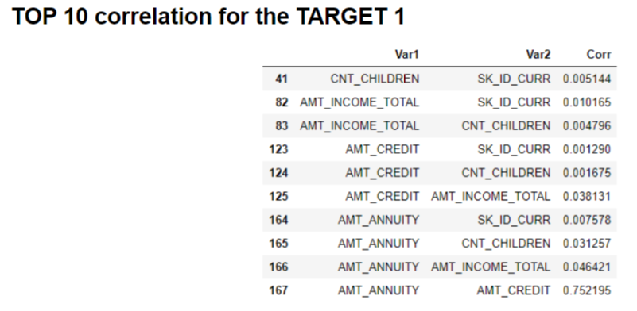
Top 10 Correlation

Slide 17
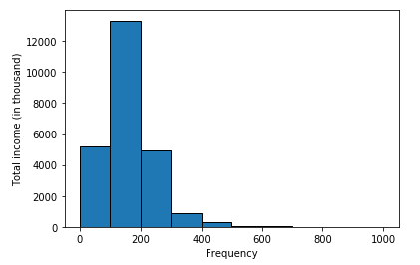
The total Income of population with Target 1

Slide 18
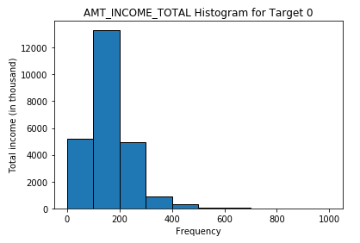
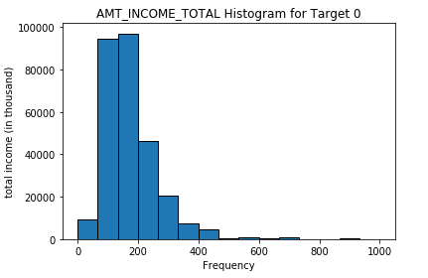
AMT INCOME TOTAL Histogram for Target 0 and 1

Slide 19
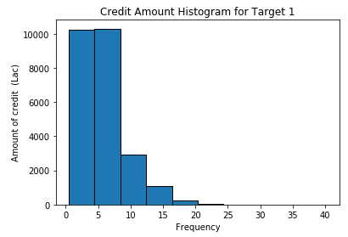
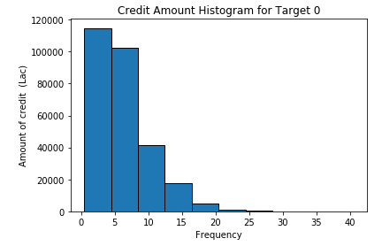
Credit Amount Histogram for Target 0 and 1

Slide 20
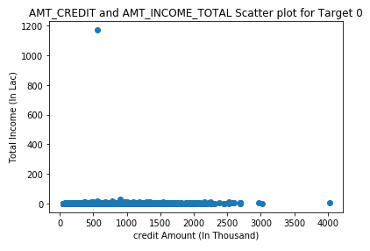
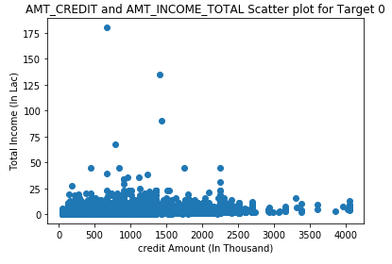
AMT_CREDIT and AMT_INCOME_TOTAL Scatter plot for Target 0 and 1

Slide 21
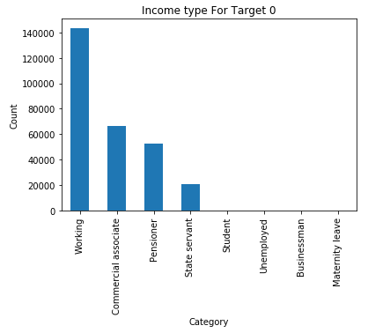
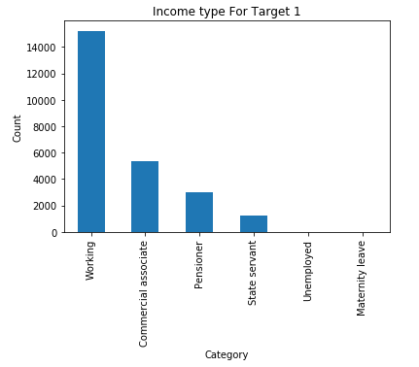
Frequency of loan application for Target 0 and 1

Slide 22
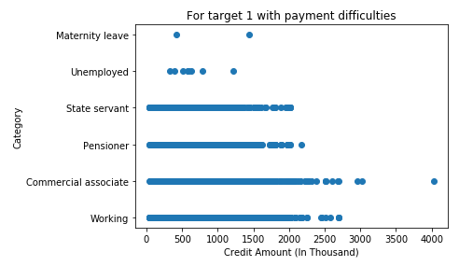
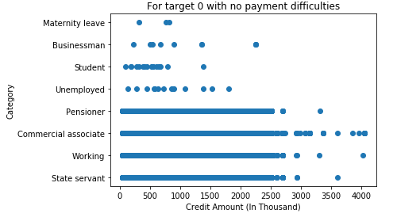
Graph for Target 1 having difficulty and for Target 0 no difficulty

Slide 23
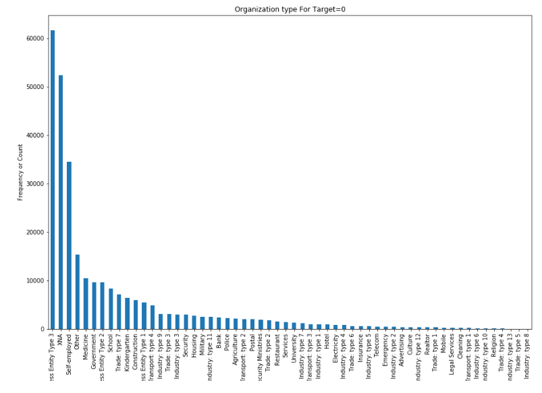
Frequency of loan for ORGANIZATION TYPE with Target 0

Slide 24
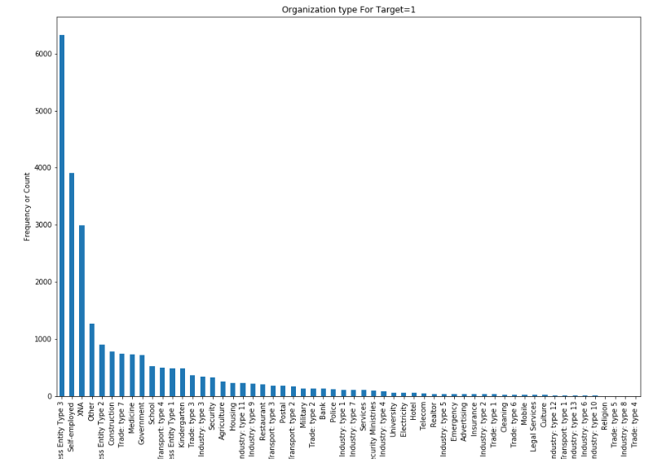
Frequency of loan for ORGANIZATION TYPE with Target 1

Slide 25
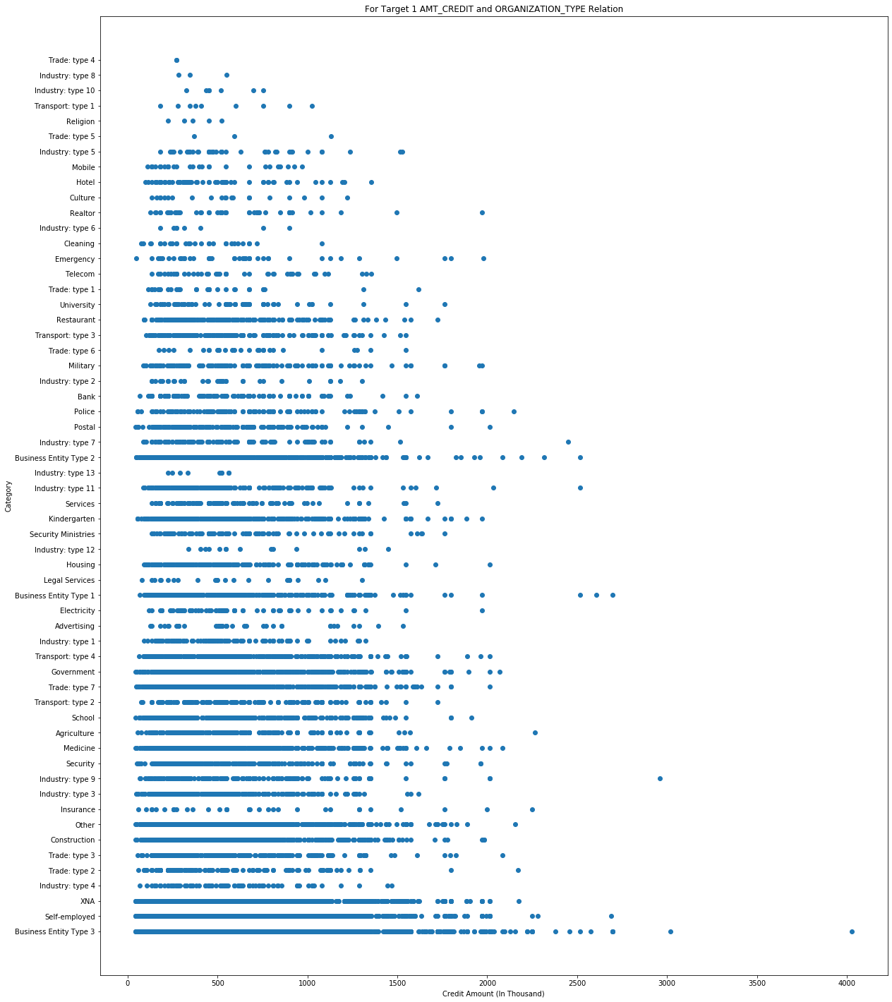
For Target 1 AMT_CREDIT and ORGANIZATION_TYPE Relation

Slide 26
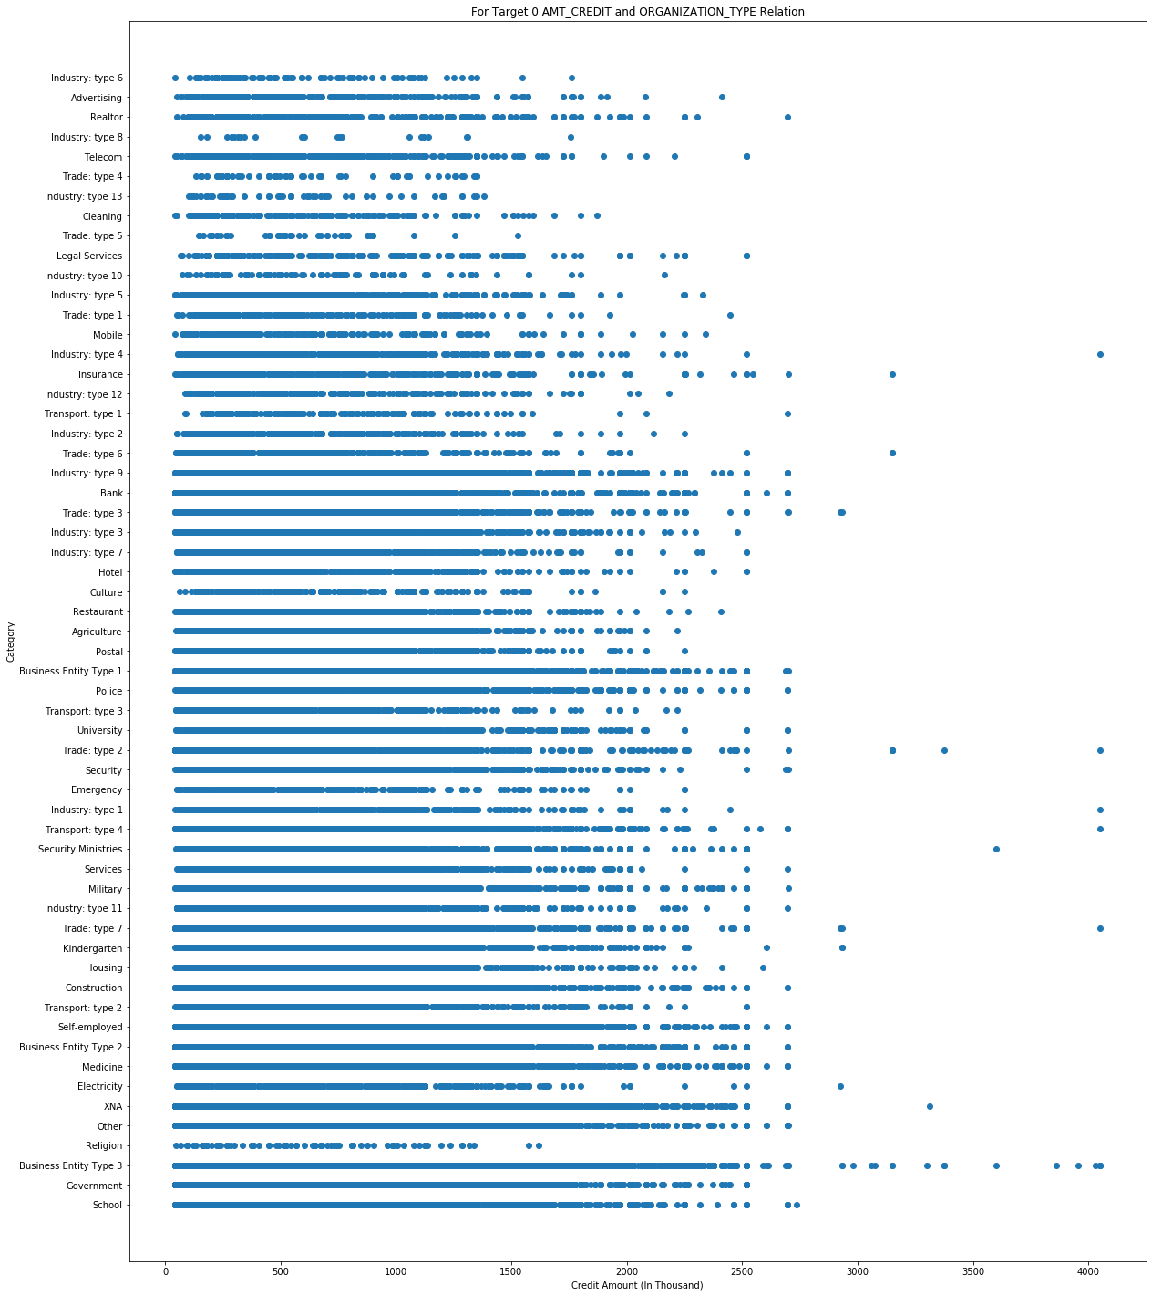
For Target 0 AMT_CREDIT and ORGANIZATION_TYPE Relation

Slide 27
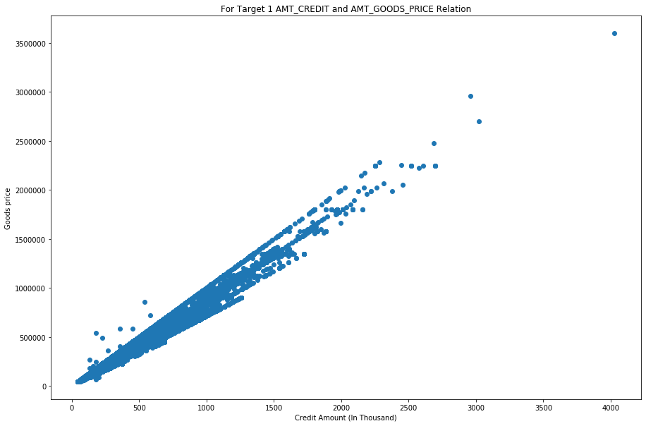
For Target 1 AMT_CREDIT and AMT_GOODS_PRICE Relation

Slide 28

Insights
For Target 1 customer having Higher Education has difficulties to replaying the loan
Can see for Credit amount for Target 0 and 1 - Target 1 between 5 to 20 Lakh have some issue in repaying the amount
Can see for Target living with Parent some issue in repaying the amount
Maximum application has been applied by working professionals

Slide 29

Conclusion for this case study
Below column are playing the major role to decide for Target 1 and 0
AMT_CREDIT : credit amount
NAME_INCOME_TYPE : Type of Income type(Working, Pensioner, Commercial associate, state Servant)
NAME_EDUCATION_TYPE : Secondary, Higher Education , Incomplete Higher, etc.

Slide 30


Rohit Keshari
&
Rahul Choudhary

